Slide 1
What's In A Name? Addressing people by the right name around the world
Kip Cole
Informal Given Name
Surname
Attribute | Value
Name Locale | en-AU
Name order | given_first
Formality | informal
Usage | addressing
Format: | medium

Slide 2
CLDR-Based
ex_cldr is the base level library that manages language tags and the locale data that supports them. Over 500 locales are supported.
ex_cldr_numbers which provides localized number formatting and parsing.
ex_cldr_currencies which provides the data about the world's currencies both current and historic.
ex_cldr_dates_times which provides localized date and time formatting (but not parsing)
ex_cldr_units which provides localized units-of-measure formatting and parsing.
ex_cldr_units_sql which provides a database type and an Ecto type for serializing units-of-measure.
ex_cldr_messages implements the Unicode Message format for localizing messages. Integrates with Gettext.
ex_cldr_calendars which provides localized calendar implementations of the Proleptic Gregorian calendar, the Julian calendar, the ISO Week calendar and provides a mechanism to define variations of the Gregorian and ISO Week calendars to meet the needs to organizations (like corporations or governments) that use different calendar periods.
ex_cldr_lists implemented localized list formatting.
ex_cldr_territories by @Schultzer provides support for localizing territory (country) information.
ex_cldr_languages by @LostKobrakai which provides support for localizing language names.
ex_cldr_collation which implements the Unicode Collation Algorithm although only the default DUCET collation.
Money
ex_money provides a full-feature money libraries focusing on correctness and reliability with support for currency specific formatting (in any locale), money parsing, amortization and basic math.
ex_money_sql provide a database type and an ecto type to simplify serialization of money without losing precision or currency tags. Also includes some aggregate function extensions for the Postgresql database.
Ecto Integration for database translations
ex_cldr_trans provides a mechanism to localized database content. It is based on the fabulous trans by @crbelaus.
Plug-based application support
ex_cldr_plugs provides plugs that can extract the requested locale for a user from different parts of the locale or the session.
ex_cldr_routes provides functions to generate and recognize localized routes. Also provides localized route helpers. Does not yet support localized verified routes. Verified routes are expected to be supported in March 2023.
ex_cldr_html which provides form helpers for selecting currencies, languages and territories. These are static HTML generators. A future ex_cldr_components will provide a more complete LiveView localized UI experience. This is not expected before year end 2023.
https://github.com/elixir-cldr
https://github.com/kipcole9/money

Slide 3
Unicode
unicode which provides introspection into the Unicode database
unicode_set which provides set operations on unicode attributes such as categories, blocks, scripts, …. It includes a regex engine that supports the Unicode regex standard (mostly).
unicode_string which locale-aware case folding, case mapping (upcase, downcase and titlecase) case-insensitive equality as well as word, line, grapheme and sentence breaking and streaming.
unicode_guards Implements Unicode Set-based guards for Elixir. Supports matching unicode sets to codepoints that can be used in function guards..
unicode_unihan functions to introspect the Unicode Unihan character database. By @jwchui.
Image
Image is an approachable image processing library primarily based upon Vix and libvips that is NIF-based, fast, multi-threaded, pipelined and has a low memory footprint.
Astro
Astronomical calculations in Elixir including sunrise, sunset, moonrise, moonset, equinox, solstice, moon phase and more.
Tz_world
Resolve time zone names from a geographic location
Kday
Calculations for the first, last or nth day of the week on, nearest, after or before a date.
https://github.com/elixir-cldr
https://github.com/elixir-unicode
https://github.com/elixir-image
https://github.com/kipcole9

Slide 4
Adam
Name

Slide 5
Adam & Eve
Name
Name

Slide 6
盤古
Name
https://en.wikipedia.org/wiki/Pangu

Slide 7
मनु
Name
https://en.wikipedia.org/wiki/Manu_(Hinduism)

Slide 8
Meanwhile, in the middle ages in England
John
William
Name
7.7%
Name
14%

Slide 9
John the butcher
Given Name
Byname

Slide 10
Cognominal
Based upon appearance, temperament
Schwartzkopf
Short
Caesar
Occupational
Based upon occupation
Butcher
Baker
Miller
Topynomic
Based upon appearance, temperament
Schwartzkopf
Short
Caesar
Ornamental
Based upon sounding like a noble
Gyldenstierne (“golden star”)
Rosenkrantz ("rose wreath")
Patronymic & Matronymic
Based upon parents' names
Andersen
O'Brien
Ali Mohamed
Stefánsdóttir
Stefanović
Petrov
Dēmētrópoulos
Fitzgerald

Slide 11
Charles Emerson Winchester
First Name
Middle Name
Last Name

Slide 12
Charles Emerson Winchester III
First Name
Middle Name
Last Name
Generation

Slide 13
Charles Emerson Winchester III M.D.
First Name
Middle Name
Last Name
Gen.
Credentials

Slide 14
Chuck
Informal First Name
A nickname of Charles, which comes from the Germanic word cheorl, meaning "free man". Could also be from the Old English chukken, meaning "to cluck".
https://www.babycentre.co.uk/babyname/1023371/chuck#

Slide 15
Sr. Miguel Ángel Juan Antonio Pablo Perez II
Title
Given Name
Other Given Names
Family Name
Other Family Names
Generation

Slide 16
Johannes Adam Ferdinand Alois Josef Maria Marko d'Aviano Pius von und zu Liechtenstein.
Surname prefix
Tussenvoegsel
https://en.wikipedia.org/wiki/Hans-Adam_II,_Prince_of_Liechtenstein
https://en.wikipedia.org/wiki/Tussenvoegsel

Slide 17
พระบาทสมเด็จพระเจ้าอยู่หัวภูมิพลอดุลยเดช Phra Bat Somdet Phra Chao Yu Hua Phumiphon Adunyadet
Title
https://en.wikipedia.org/wiki/Thai_royal_ranks_and_titles

Slide 18
Different way to construct names
There is a wide variety in the way that people’s names appear in different languages.
People may have a different number of names, depending on their culture—they might have only one name (“Zendaya”), two (“Albert Einstein”), or three or more.
People may have multiple words in a particular name field, eg “Mary Beth” as a given name, or “van Berg” as a surname.
Some languages, such as Spanish, have two surnames (where each can be composed of multiple words).
The ordering of name fields can be different across languages, as well as the spacing (or lack thereof) and punctuation.
Name formatting needs to be adapted to different circumstances, such as a need to be presented shorter or longer; formal or informal context; or when talking about someone, or talking to someone, or as a monogram (JFK).

Slide 19

https://cldr.unicode.org

Slide 20
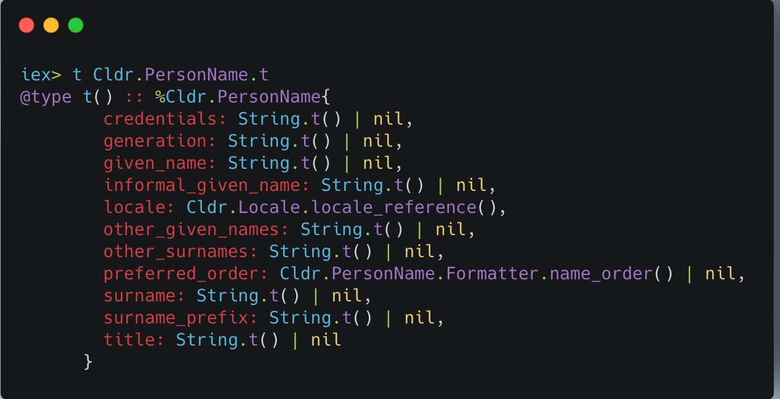
Structure of a name
Three ways to provide data to the formatter:
Cldr.PersonName.t struct
Cldr.PersonName behaviour
Cldr.PersonName.Format protocol

Slide 21
How we use names
Formality, usage, name order, …

Slide 22
Formality
Formality indicates the formality of usage. A name on a badge for an informal gathering may be much different from an award announcement at the Nobel Prize Ceremonies.
Note that the formats may be the same for different formality scenarios depending on the length, usage, and cultural conventions for the locale. For example, short formal and short informal may both be just the given name.
Formality | Description
formal | A more formal name for the individual. The composition depends upon the language. For example, a particular locale might include the title, generation, credentials and a full middle name (given2) in the long form. length="medium", formality="formal" “Robert J. Smith”
informal | A less formal name for the individual. The composition depends upon the language. For example, a language might exclude the title, credentials and given2 (middle) name. Depending on the length, it may also exclude the surname. The formatting algorithm should choose any passed in name data that has an informal attribute, if available. length="medium", formality="informal" “Bob Smith”

Slide 23
Usage
The usage indicates if the formatted name is being used to address someone, refer to someone, or present their name in an abbreviated form.
Usage | Description
addressing | Used when speaking “to” a person, or “vocative” case. This may also have an effect on the formality. example: “Welcome, Robert”
referring | Used when speaking “about” a person, or “nominative” case. example: “Robert Smith joined your group”
monogram | The monogram usage is for a specific abbreviated form for computer UI. Example: a monogram for Robert James Smith may be RS or RJS.

Slide 24
Name Order
The order attribute is used for patterns with different orders of fields.
The sorting patterns are chosen based on input parameters, while the choice between given_first and surname_first is based on features of the PersonName object to be formatted and the name_order element values for a locale.
For example, when the display language is Japanese, it is customary to use surname_first for names of people from Japan and Hungary, but use given_first for names of people from the United States and France. Although the English pattern for sorting is distinct from the other patterns (except for unusual names), that is not necessarily the case in other languages.
Name Order | Description
given_first | The given name precedes the surname.
surname_first | The surname precedes the given name.
sorting | Used to format names for a sorted list. example: “Brown, William” [medium, informal]

Slide 25
Formatting a name
The formatting locale. This is used to choose the primary set of patterns to format name data.
The name locale. If the name data comes from a locale different from the formatting locale, it may need to be handled differently. If the name locale is not known, an inferred name locale is derived from the information in the name and the formatting locale.
Input parameters.
order - indicates whether the given name comes first or the surname. This is normally specified in the CLDR data for the locale. This feature is also used for the sorting format.
format - used to select patterns for common short, medium, and long formatted names.
usage - this is used to select the correct pattern to format a name when a program is addressing or talking to a person or it is referring to or talking about another person.
formality - This is used to select the formal or informal formatting of a name.

Slide 26
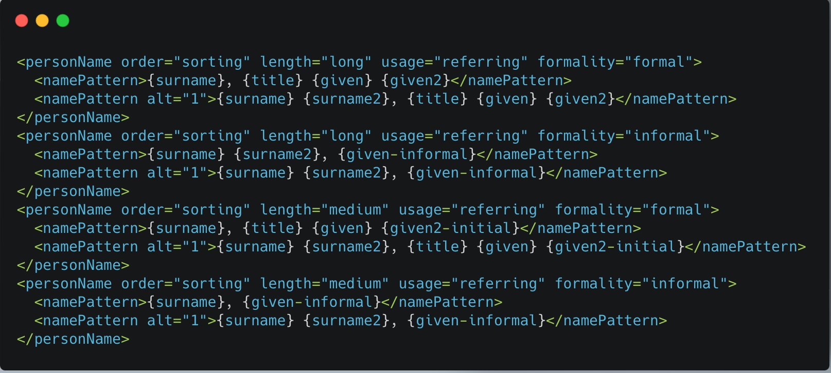
Format templates in CLDR Example from the "es" locale

Slide 27
Down the rabbit hole
Initialisation of a name requires knowing how to break words
That requires Unicode break algorithm -> unicode_strings
Which needs Unicode sets -> unicode_sets
Which needs enhanced regular expressions -> unicode_regex
Which needs Unicode introspection -> unicode

Slide 28
Livebook examples
https://github.com/elixir-cldr/cldr_person_names/blob/main/person_name_formatting_explorer.livemd

Slide 29
What's Not in CLDR scope
Grammatical inflection of formatted names.
Context-specific cultural aspects, such as when to use “-san” vs “-sama” when addressing a Japanese person.
Providing locale-specific lists of titles, generation terms, and credentials for use in pull-down menus or validation (Mr, Ms., Mx., Dr., Jr., M.D., etc.).
Validation of input, such as which fields are required, and what characters are allowed.
Combining alternative names, such as multicultural names in Hong Kong "Jackie Chan Kong-Sang”, or ‘Dwayne “The Rock” Johnson’ [However, personas]
More than two levels of formality for names.
Parsing of names.

Slide 30
Parsing is hard
Parsing of name strings into specific name parts such as given_name and other_given_names is ambiguous. A name like "Mary Beth Estrella" could conceivably be any of the following.
Given Name | Other Given Names | Surname | Other Surnames
Mary | Beth | Estrella
Mary Beth |  | Estrella
Mary |  | Beth Estrella
Mary |  | Beth | Estrella

Slide 31
What's not covered But I'd like to find a way
Salutations
Illustrissime et Éminentissime Seigneur
(Most Illustrious and Most Eminent Lord)
Valedictions
Veuillez agréer, Madame, Monsieur, l'expression de mes sentiments distingués"
(Please accept, Madam, Sir, the expression of my distinguished sentiments)
Personas
https://en.wikipedia.org/wiki/Salutation
https://en.wikipedia.org/wiki/Valediction

Slide 32
Timetable
CLDR 45 will be released in April. See https://cldr.unicode.org/index/downloads/cldr-45
ex_cldr 2.38 and all necessary updates will be out the same day as CLDR 45 is released
ex_person_names will be available on the same day
Available now for experimentation by configuring as: {:ex_cldr_person_names, github: "elixir-cldr/cldr_person_names"}

Slide 33
